Slide 1
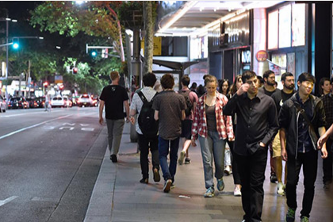
Pedestrian Surveys In Melbourne & Sydney
Team number : 9
Student One: Sothearith Kaing, s8170868 — Project 1: Walking Count Surveys: City of Sydney
Student Two: Justin Dang, s8149950 — Project 2: City of Melbourne Pedestrian Counting System
Unit code and title: NIT2202 Big Data
NIT2202 Big Data · Team Presentation
1
Notes:
Owned by Student One. Team number, Student One's name/ID and the Project 1 topic must be supplied by the teammate — these were deliberately not invented. Justin's details are pre-filled and can be left as is.

Slide 2
PROJECT 2 · JUSTIN DANG · S8149950
AWS Architecture — Pedestrian Counting Pipeline
City of Melbourne
Open Data
Amazon S3
Snowflake
Tableau Cloud
Publishes the source data
Stores the original CSV
Loads, validates, transforms
Queries the view, visualises
Pedestrian Counting System —
monthly counts per hour
CSV, downloaded manually
Bucket:
nit2202-s8149950-
pedestrian-data
Prefix: raw-data/
Warehouse: S8149950_WH
DB: S8149950_PEDESTRIAN_DB
RAW → PEDESTRIAN_COUNTS_RAW
ANALYTICS →
PEDESTRIAN_COUNTS_CLEAN
Live connection to the
ANALYTICS view
Melbourne Pedestrian
Activity Dashboard
Manual download
and upload
Batch load
(COPY INTO)
Live query
connection
Batch, not real time. The CSV was downloaded, uploaded to S3 and loaded into Snowflake as a one-off batch process. Only the Tableau Cloud connection to the Snowflake analytics view is live, so dashboard interactions query Snowflake directly.
NIT2202 Big Data · Team Presentation
2
Notes:
SOURCE: object names taken from the student's own implementation (LiveDemo_JustinDang_s8149950 evidence slides: S3 console, Snowflake worksheet, Tableau Cloud connection pane).
Q (teammate): "Justin, can you explain how the pedestrian dataset moves through your architecture?"
A (Justin): "Certainly. I downloaded the hourly pedestrian-counting CSV from the City of Melbourne Open Data portal and stored the original file in Amazon S3, in the raw-data prefix of the nit2202-s8149950-pedestrian-data bucket. Snowflake reads that file through an external stage and loads it into a raw table, PEDESTRIAN_COUNTS_RAW. I then expose cleaned analytical fields through a view in the ANALYTICS schema, PEDESTRIAN_COUNTS_CLEAN. Tableau Cloud connects live to that view to build the dashboard. So each platform has one job: S3 keeps the original file, Snowflake does the loading and transformation, and Tableau does the visualisation."
FOLLOW-UP Q: "Is that pipeline running automatically?"
A: "No, and I want to be precise about that. The upload to S3 and the COPY INTO load in Snowflake were a manual batch process — I ran them once. What is live is the Tableau-to-Snowflake connection, so when someone filters the dashboard it queries Snowflake in real time rather than reading a saved extract. Automating the ingestion would be the next step, using something like Snowpipe."

Slide 3
PROJECT 2 · DATA SOURCE
Data Source and Synchronisation
Dataset
How the data moves
Source
City of Melbourne Open Data
BATCH · MANUAL
Dataset
Pedestrian Counting System — monthly counts per hour
CSV → Amazon S3 → Snowflake
The file is downloaded from the City of Melbourne portal, uploaded to the S3 bucket and loaded into Snowflake with COPY INTO. This ran once — it is not continuous synchronisation.
Format
CSV, approx. 120 MB
Records
1,616,044
Sensors
103 locations
LIVE · ON DEMAND
Tableau Cloud → Snowflake ANALYTICS view
Date range
14 Aug 2024 – 13 Aug 2026
Tableau uses a live connection rather than an extract, so every filter, hover and drill-down issues a fresh query against PEDESTRIAN_COUNTS_CLEAN.
Main fields Location ID · sensing date · hour of day · two directional counts · total pedestrian count · sensor name · latitude and longitude
Source: City of Melbourne Open Data, Pedestrian Counting System (counts per hour). Record counts verified in Snowflake.
NIT2202 Big Data · Team Presentation
3
Notes:
SOURCES: dataset title and publisher — City of Melbourne Open Data portal, https://data.melbourne.vic.gov.au/explore/dataset/pedestrian-counting-system-monthly-counts-per-hour/. Record count, sensor count and date range verified by the student's own Snowflake data-quality query (1,616,044 rows; 103 sensors; 2024-08-14 to 2026-08-13).
Q (teammate): "Where does this data actually come from, and how current is it?"
A (Justin): "It's an open dataset published by the City of Melbourne — hourly pedestrian counts from sensors mounted around the CBD. I used the monthly counts-per-hour extract, which came to just over 1.6 million rows across 103 sensor locations, covering August 2024 to August 2026. Each row is one sensor for one hour, with two directional counts, a combined total, the sensor name and its coordinates."
FOLLOW-UP Q: "So is the dashboard showing live pedestrian data?"
A: "Two different things are happening, and it's worth separating them. Getting the data in was a batch job — I downloaded the CSV, put it in S3 and ran COPY INTO once. So the data itself is a snapshot, not a live feed. But Tableau's connection to Snowflake is live, so the dashboard isn't querying a stale extract; every interaction hits the Snowflake view directly. To make the underlying data current you'd schedule the ingestion, and the City of Melbourne refreshes the source monthly."

Slide 4
PROJECT 2 · AUDIENCE
Target Consumers
Who uses the dashboard, and the decision it supports
Transport and urban planning
City operations and events
City of Melbourne
City of Melbourne
Identify sustained high-demand locations from the sensor map and monthly trend.
Read peak periods from the day-and-hour heatmap, including the afternoon commute.
Decision supported: Where to widen footpaths, add crossings or upgrade pedestrian infrastructure.
Decision supported: When to roster staff, schedule works and position crowd-management resources.
Local businesses and retailers
Researchers and policy analysts
CBD traders
Universities, government
Compare footfall between sensor locations and across hours of the day.
Study pedestrian behaviour and how activity shifts over a two-year window.
Decision supported: Trading hours, staffing levels and where to site a shopfront or promotion.
Decision supported: Evidence for transport, planning and public-space policy work.
Highlighted consumers are the primary audience: the dashboard was built around the City of Melbourne's own planning and operations questions.
NIT2202 Big Data · Team Presentation
4
Notes:
SOURCE: consumer groups reflect the stated purpose of the Pedestrian Counting System as described by the City of Melbourne — monitoring pedestrian activity over time to inform decision-making and future planning (https://www.melbourne.vic.gov.au/pedestrian-counting-system). No usage figures or named businesses are claimed.
Q (teammate): "Who would actually open this dashboard day to day?"
A (Justin): "The primary audience is the City of Melbourne itself, in two different teams. Transport and urban planning care about the map and the monthly trend — they need to know which locations carry sustained demand before committing to footpath widening or a new crossing. City operations and event teams care about the heatmap, because their question is timing: when do we need extra staff or crowd management. Secondary audiences are CBD retailers, who want to know footfall by location and hour, and researchers who want a two-year behavioural record."
FOLLOW-UP Q: "Which one drove your design choices?"
A: "The council planning use case. That's why the map is sized by average count rather than total — a total would just reward sensors that have been installed longest. And it's why I kept the sensors with missing metadata in the row counts but filtered them off the map, so the totals stay honest even though 25,000 rows can't be plotted."

Slide 5
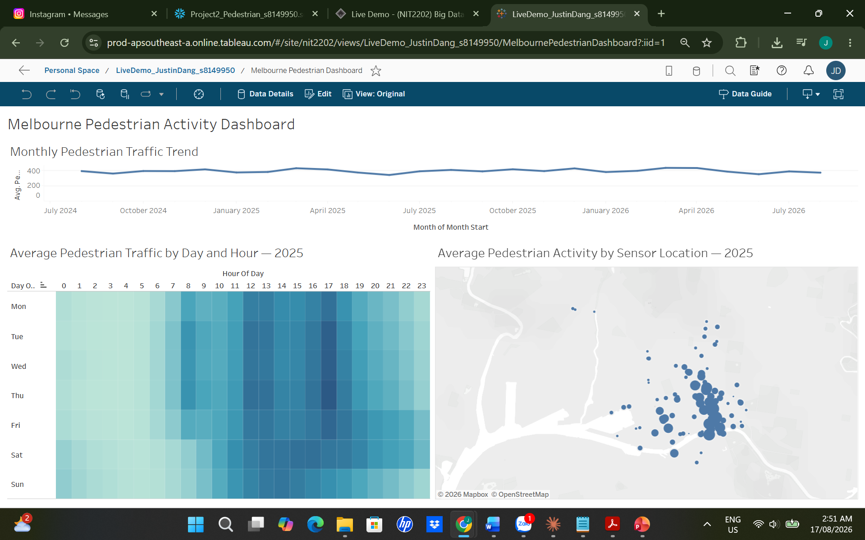
PROJECT 2 · DASHBOARD
Dashboard Insights and Business Value
What the dashboard shows
Pedestrian activity rises and falls across the months rather than holding flat.
Daytime and afternoon hours are consistently busier than overnight hours.
Many of the busiest sensors peak around 17:00, at the afternoon commute.
Activity is spatially concentrated — sensor volumes differ sharply by location.
Business value
Evidence-based infrastructure planning
Shows when and where demand is highest
Supports event planning and resourcing
Helps traders read footfall by time and place
Melbourne Pedestrian Activity Dashboard, Tableau Cloud (live connection to Snowflake).
NIT2202 Big Data · Team Presentation
5
Notes:
SOURCE: screenshot is the student's own published Tableau Cloud dashboard, Melbourne Pedestrian Activity Dashboard, captured 17 August 2026. Peak-hour observation is supported by the Snowflake DENSE_RANK query in the live demo, which returned 17:00 as the peak hour for eight of the ten busiest 2025 sensors. No percentages or dollar values are claimed.
Q (teammate): "Walk me through what the dashboard tells you that the raw data didn't."
A (Justin): "Three views, three different questions. The trend line at the top answers 'is the city getting busier' — and you can see activity moves in a repeating seasonal pattern rather than climbing steadily. The heatmap answers 'when' — the daytime and afternoon blocks are clearly darker than overnight, and the heaviest band sits around the late afternoon. The map answers 'where' — activity clusters tightly in the central retail core, and circle size varies a lot between sensors only a few streets apart. On their own those are three facts; together they let a planner say where and when to act."
FOLLOW-UP Q: "What's the single most actionable finding?"
A: "The 17:00 concentration. My ranking query showed that eight of the ten busiest sensors in 2025 hit their peak hour at 5pm, and the other two peaked at 1pm. That's a very consistent commuter signal, and it means interventions targeted at that window — signal timing, temporary widening, staff placement — would reach the largest number of people. I'd want to stress that's an average-per-hour finding across 2025, not a claim about any single day."

Slide 6
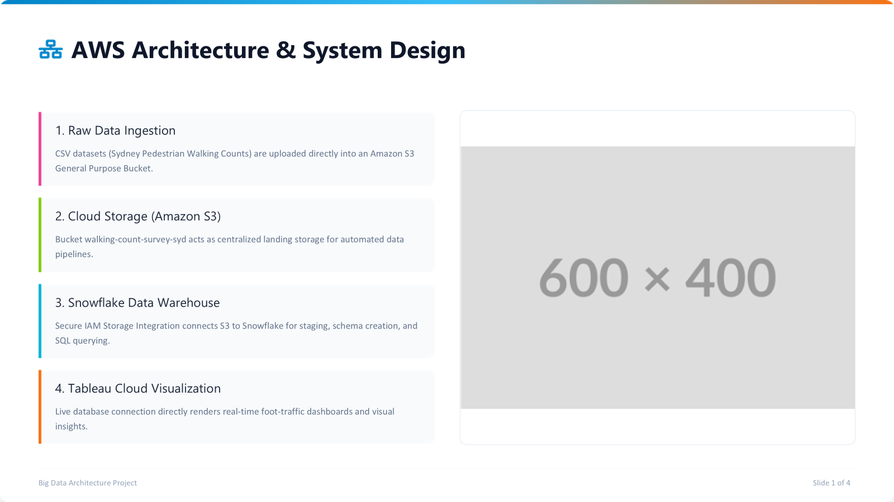
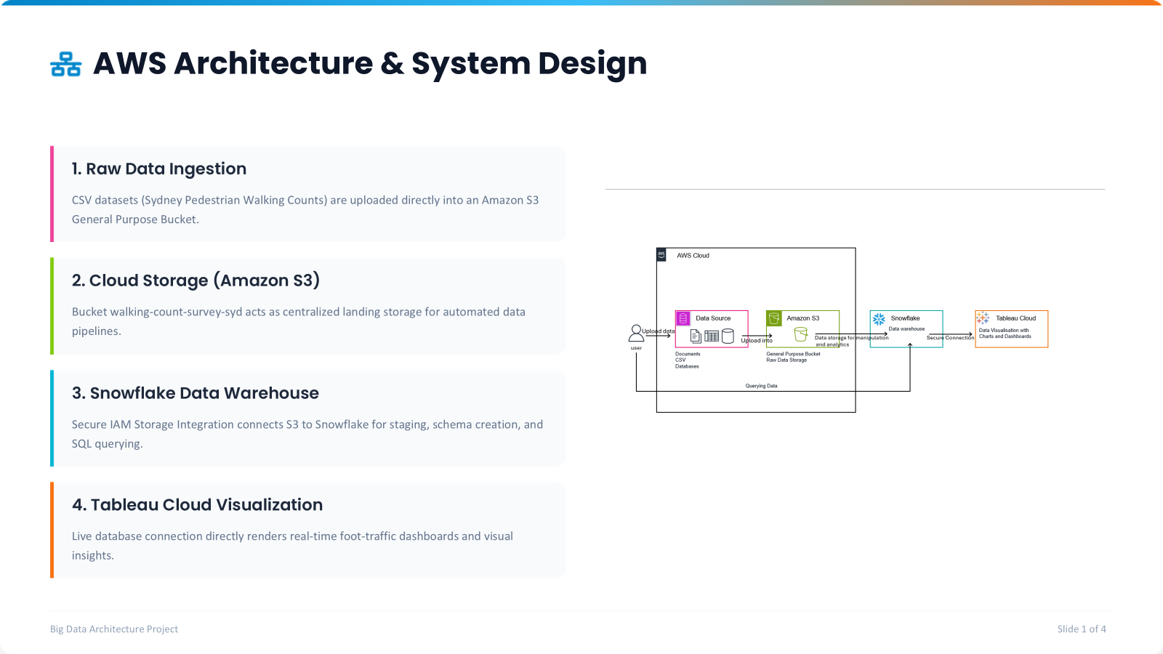
PROJECT 2 · DASHBOARD
Dashboard Insights and Business Value
What the dashboard shows
Pedestrian activity rises and falls across the months rather than holding flat.
Daytime and afternoon hours are consistently busier than overnight hours.
Many of the busiest sensors peak around 17:00, at the afternoon commute.
Activity is spatially concentrated — sensor volumes differ sharply by location.
Business value
Evidence-based infrastructure planning
Shows when and where demand is highest
Supports event planning and resourcing
Helps traders read footfall by time and place
Melbourne Pedestrian Activity Dashboard, Tableau Cloud (live connection to Snowflake).
NIT2202 Big Data · Team Presentation
5
Notes:
SOURCE: screenshot is the student's own published Tableau Cloud dashboard, Melbourne Pedestrian Activity Dashboard, captured 17 August 2026. Peak-hour observation is supported by the Snowflake DENSE_RANK query in the live demo, which returned 17:00 as the peak hour for eight of the ten busiest 2025 sensors. No percentages or dollar values are claimed.
Q (teammate): "Walk me through what the dashboard tells you that the raw data didn't."
A (Justin): "Three views, three different questions. The trend line at the top answers 'is the city getting busier' — and you can see activity moves in a repeating seasonal pattern rather than climbing steadily. The heatmap answers 'when' — the daytime and afternoon blocks are clearly darker than overnight, and the heaviest band sits around the late afternoon. The map answers 'where' — activity clusters tightly in the central retail core, and circle size varies a lot between sensors only a few streets apart. On their own those are three facts; together they let a planner say where and when to act."
FOLLOW-UP Q: "What's the single most actionable finding?"
A: "The 17:00 concentration. My ranking query showed that eight of the ten busiest sensors in 2025 hit their peak hour at 5pm, and the other two peaked at 1pm. That's a very consistent commuter signal, and it means interventions targeted at that window — signal timing, temporary widening, staff placement — would reach the largest number of people. I'd want to stress that's an average-per-hour finding across 2025, not a claim about any single day."

Slide 7

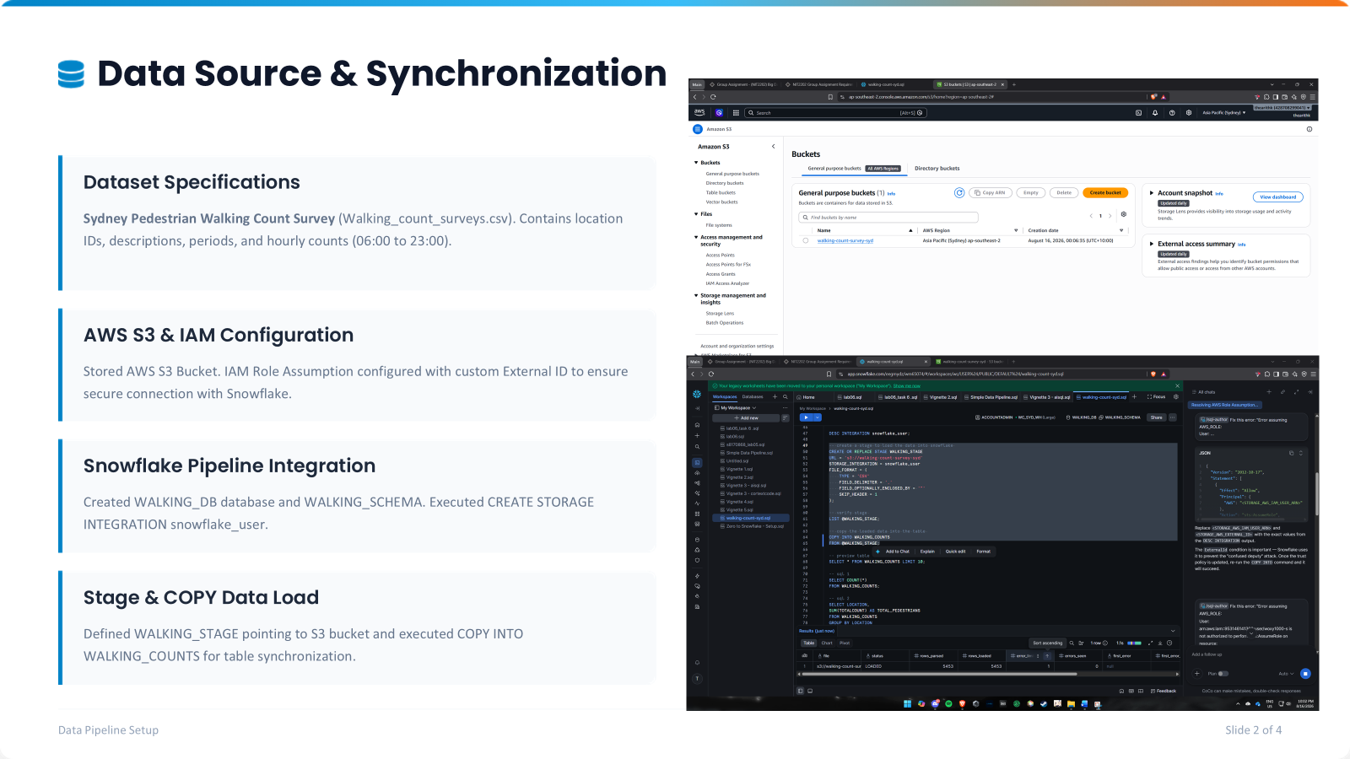





Data Source & Synchronization
Dataset Specifications
Sydney Pedestrian Walking Count Survey (Walking_count_surveys.csv). Contains location IDs, descriptions, periods, and hourly counts (06:00 to 23:00).
AWS S3 & IAM Configuration
Stored in ap-southeast-2. IAM Role Assumption configured with custom External ID to prevent confused deputy security attacks.
Snowflake Pipeline Integration
Created WALKING_DB database and WALKING_SCHEMA. Executed CREATE STORAGE INTEGRATION snowflake_user for automated AWS trust.
Stage & COPY Data Load
Defined WALKING_STAGE pointing to S3 bucket and executed COPY INTO WALKING_COUNTS for continuous table synchronization.
Data Pipeline Setup
Slide 2 of 4

Slide 8






Target Consumers & Stakeholders
Urban & City Planners
Retail & Commercial
Transit & Public Safety
Optimize municipal infrastructure and pedestrian mobility across Sydney CBD.
Empower commercial developers and business owners with footfall intelligence.
Enhance public transport alignment and municipal emergency management.
•
Sidewalk widening & zone planning
•
Optimal store site selection
•
Bus & light rail frequency planning
•
Traffic signal timing calibration
•
Footfall-driven rental valuation
•
Major event crowd management
•
Pedestrian corridor safety assessment
•
Peak hour staffing optimization
•
Emergency evacuation route planning
Stakeholder Value & Analytics
Slide 3 of 4

Slide 9
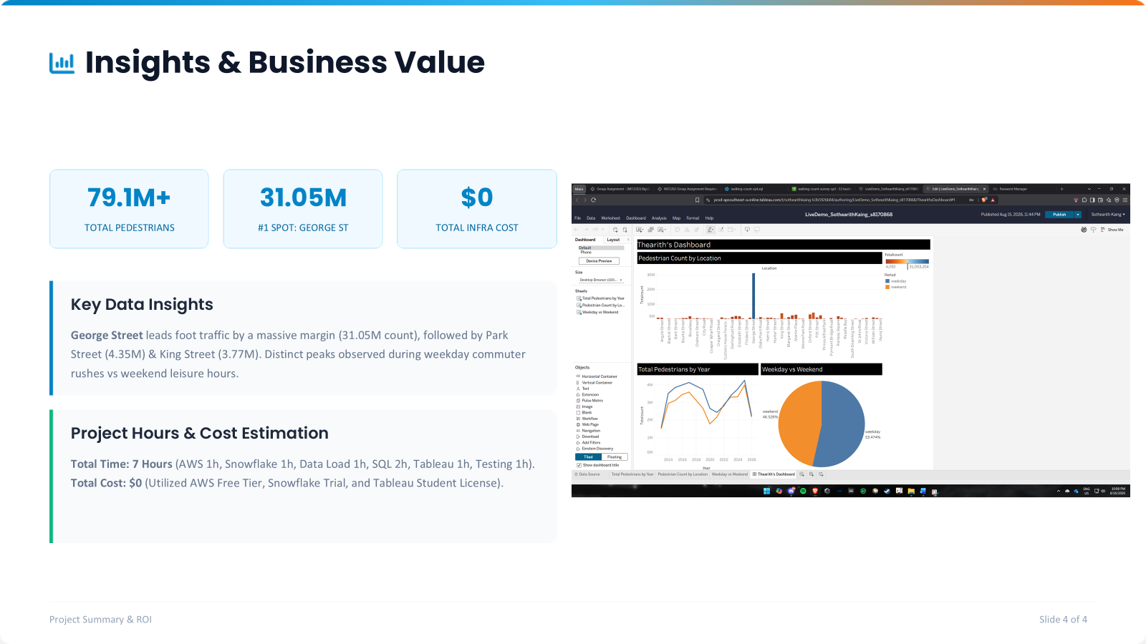





Insights & Business Value
79.1M+
31.05M
$0
TOTAL PEDESTRIANS
#1 SPOT: GEORGE ST
TOTAL INFRA COST
Key Data Insights
George Street leads foot traffic by a massive margin (31.05M count), followed by Park Street (4.35M) & King Street (3.77M). Distinct peaks observed during weekday commuter rushes vs weekend leisure hours.
Project Hours & Cost Estimation
Total Time: 7 Hours (AWS 1h, Snowflake 1h, Data Load 1h, SQL 2h, Tableau 1h, Testing 1h).
Total Cost: $0 (Utilized AWS Free Tier, Snowflake Trial, and Tableau Student License).
Project Summary & ROI
Slide 4 of 4

Slide 10
PRESENTED BY STUDENT TWO · JUSTIN DANG
References and AI Acknowledgement
AI acknowledgement
Amazon Web Services. (2026). Amazon Simple Storage Service user guide. https://docs.aws.amazon.com/AmazonS3/latest/userguide/Welcome.html
City of Melbourne. (2026). Pedestrian counting system (counts per hour) [Data set]. City of Melbourne Open Data. https://data.melbourne.vic.gov.au/explore/dataset/pedestrian-counting-system-monthly-counts-per-hour/
City of Melbourne. (2026). Pedestrian counting system. https://www.melbourne.vic.gov.au/pedestrian-counting-system
Shi, H. (2026). NIT2202 group assignment requirements [Unit materials]. Victoria University.
City of Sydney. (2026, April 21). Walking count surveys [Data set]. https://data.cityofsydney.nsw.gov.au/datasets/cityofsydney::walking-count-surveys/about
Snowflake Inc. (2026). Bulk loading from Amazon S3. Snowflake documentation. https://docs.snowflake.com/en/user-guide/data-load-s3
Snowflake Inc. (2026). COPY INTO <table>. Snowflake documentation. https://docs.snowflake.com/en/sql-reference/sql/copy-into-table
Tableau. (2026). Snowflake. Tableau help. https://help.tableau.com/current/pro/desktop/en-us/examples_snowflake.htm
Generative AI tools were used to support the structuring, wording and visual design of this presentation.
All technical work — the AWS S3 configuration, Snowflake loading and SQL, and the Tableau dashboard — was implemented by the students.
The students reviewed and verified every figure, screenshot and claim, and remain fully responsible for the final content and for explaining the design decisions behind it.
NIT2202 Big Data · Team Presentation
10
Notes:
Presented by Student Two (Justin) per the assignment requirement that if Student One presents the cover, Student Two presents the references.
All URLs above were checked at the time of writing; re-verify before submission and confirm your unit's preferred APA 7 treatment of software documentation. The unit-materials entry lists the assignment requirements document author as shown on that document; adjust if your unit guide prefers a different form.
Project 1 references are a placeholder — they must come from the teammate.
Q (teammate): "Anything you'd flag about how the deck was put together?"
A (Justin): "Yes — we used generative AI to help structure and word the slides and to lay out the diagram. The implementation was ours: the S3 bucket, the Snowflake load and queries, and the Tableau dashboard. We checked every number on these slides against our own query output, and we can explain any of the design decisions."

